Slide 1


ATLIQO ANALYSIS
AtliQ is one of the leading telecom providers in India and launched its 5G plans in May 2022 along with other telecom providers

Slide 2

Let’s See
Atliqo Company
Revenue
Market Shares of Some Companies
Average Revenue Per User
Total Active Users
Launched Plan
Total Unsubscribed Users

Slide 3
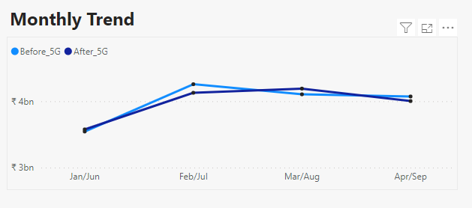
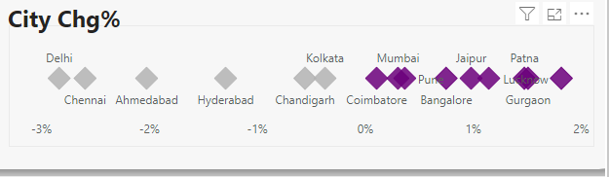
Revenue
Atliqo is telecom company
It’s total revenue in 2022
Rs 31.9 billion
IN may 22, it launches new 5G plan
Revenue Before 5G- Rs 16 billion
Revenue After 5G- Rs 15.9 billion
From above we can see that, revenue after launch decrease.

Slide 4
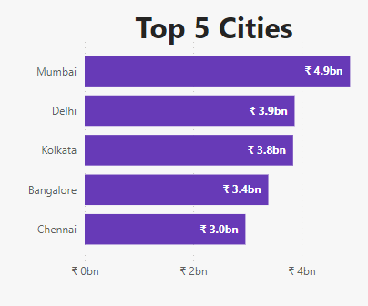
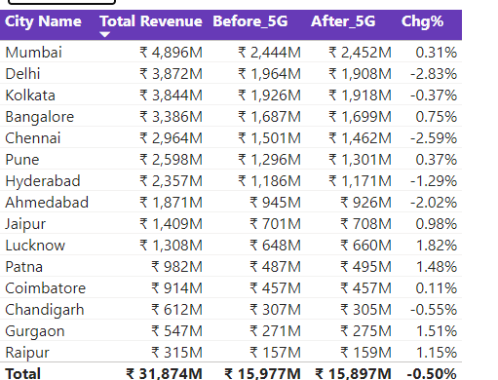
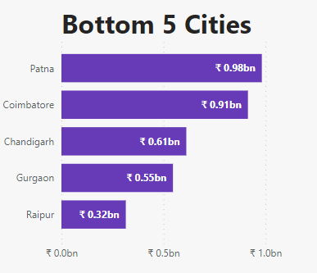

Slide 5
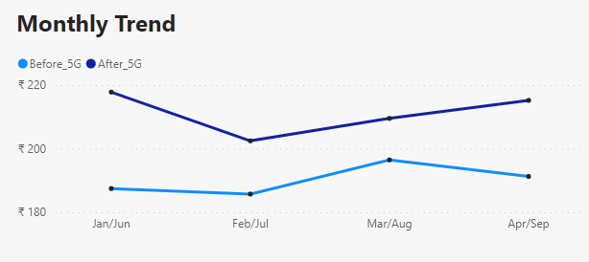
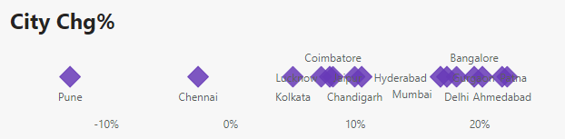
Average revenue per user (ARPU)
ARPU in 2022
Rs 200.7
IN may 22, it launches new 5G plan
ARPU Before 5G- Rs 190.2
ARPU After 5G- Rs 211.3
From above we can see that, ARPU after launch Increase.

Slide 6
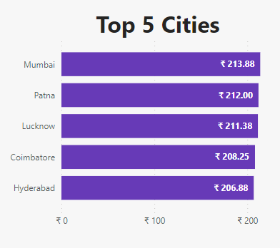
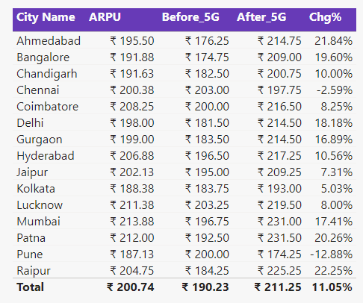
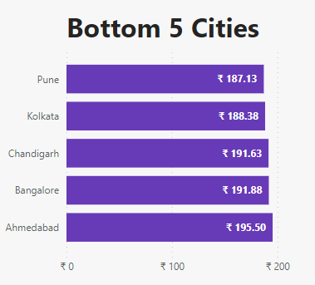

Slide 7
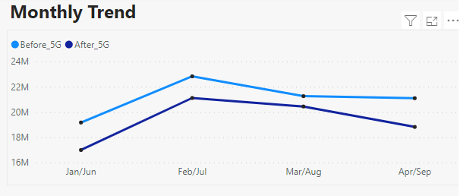
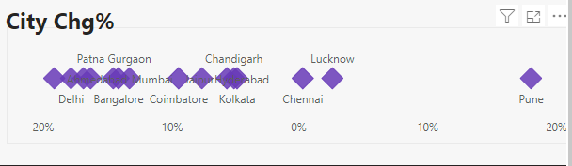
Total Active Users (TAU)
TAU in 2022
161.7 M
IN may 22, it launches new 5G plan
TAU Before 5G- 84.4 M
TAU After 5G- 77.4 M
From above we can see that, TAU after launch Decrease.

Slide 8
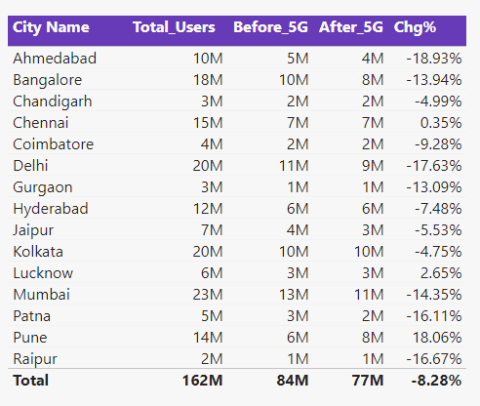
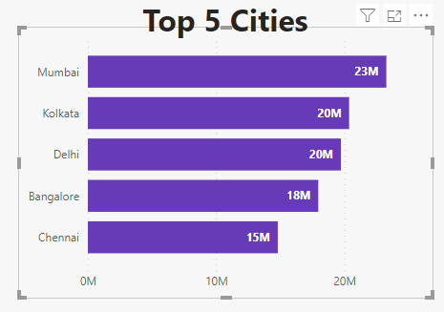
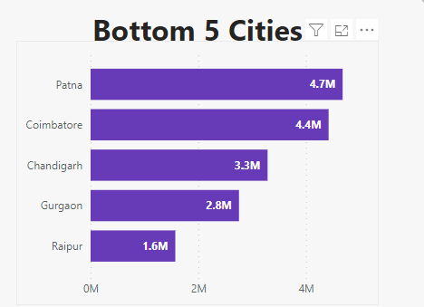

Slide 9
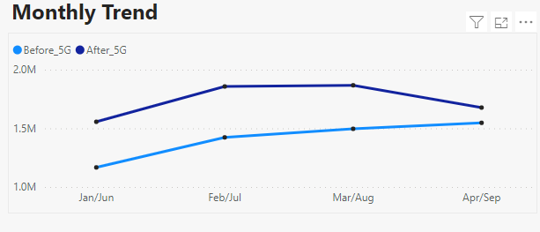
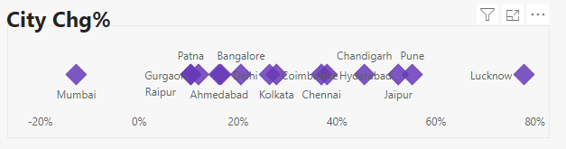
Total Unsubscribed Users (TUsU)
TUsU in 2022
12.6 M
IN may 22, it launches new 5G plan
TUsU Before 5G- 5.6 M
TUsU After 5G- 7 M
From above we can see that, TUsU after launch Increase.

Slide 10
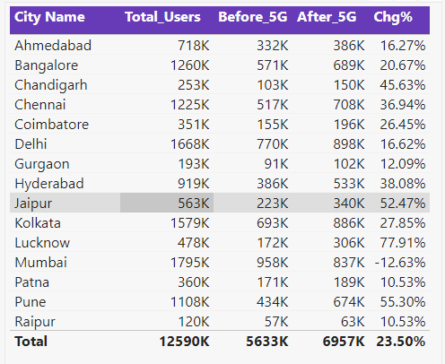
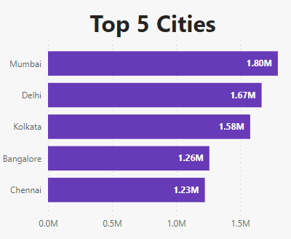
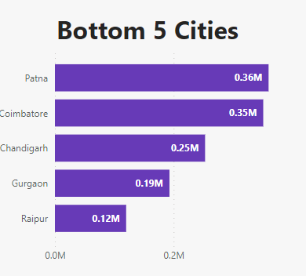

Slide 11
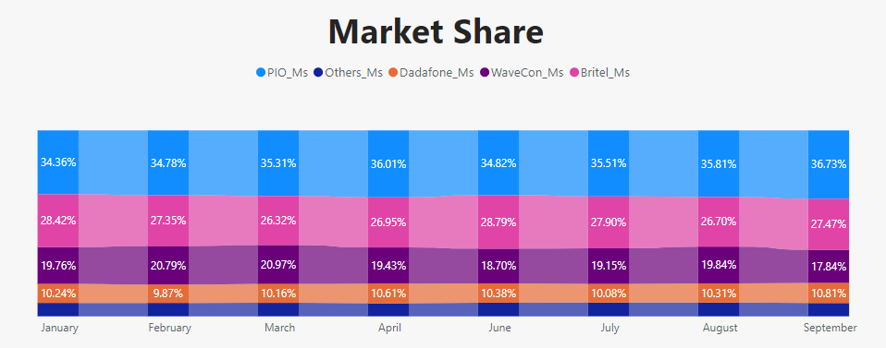
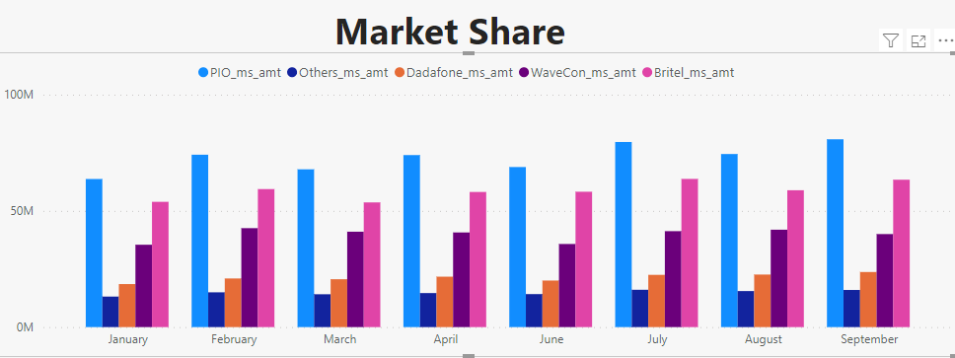
Average of Market share % month wise show which company gives more share and less. Here PIO gives more share
Market share amount month wise

Slide 12
